Slide 1

GROUP 1
Shivani Ravindra Kedar
Sai Bhavanesh Darisi
Jilson Correia
Chenghao Shi
Anshika Khandelwal
INTEGRATED INVESTMENT MANAGEMENT DATABASE SYSTEM

Slide 2

Overview
Our platform's mission is to revolutionize the stock trading experience by providing investors with a comprehensive solution for comparing platform policies, managing investment portfolios, and accessing specialist consultant services. Users can easily compare the policies of different stock trading platforms, store and manage their basic information, track their investment portfolios, securely store transaction records, and access personalized guidance from specialist consultants. We aim to empower investors with the tools and resources they need to make informed investment decisions and achieve their financial goals efficiently.

Slide 3
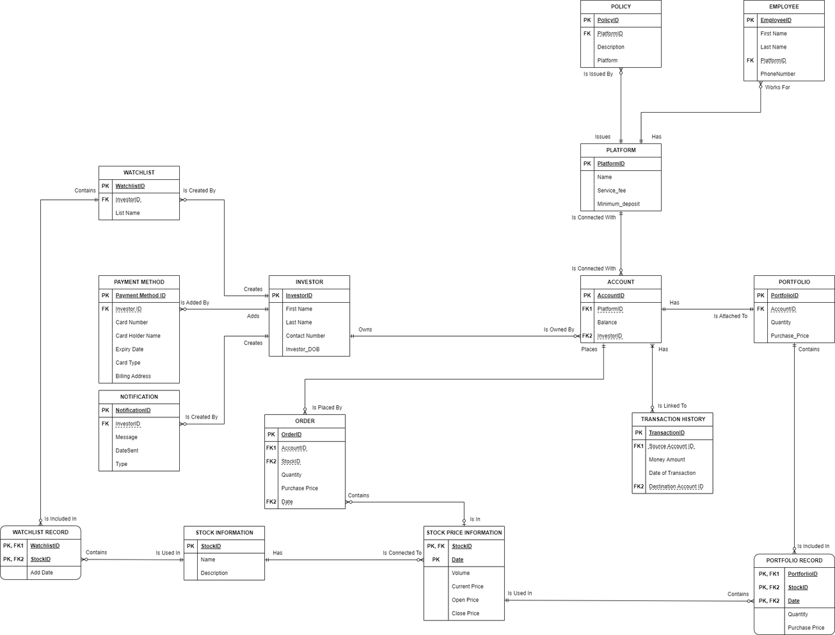

E-R Diagram

Slide 4
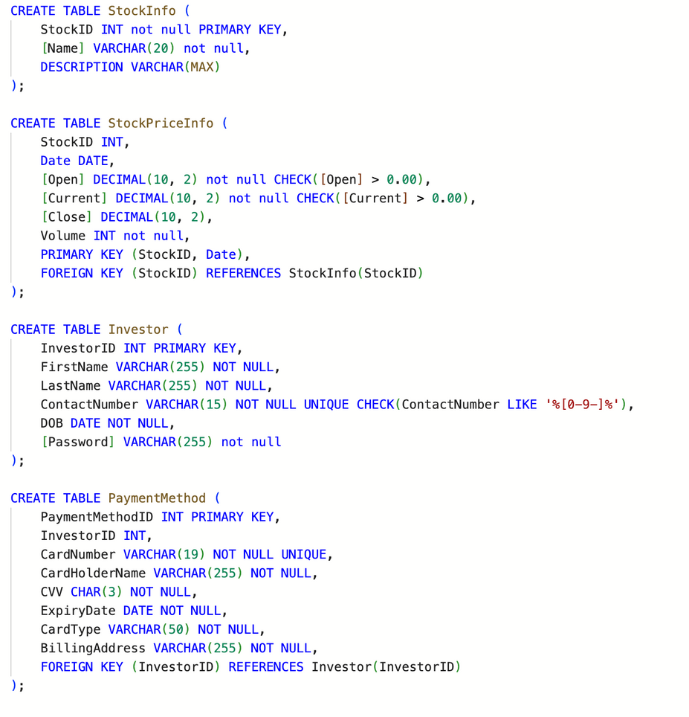
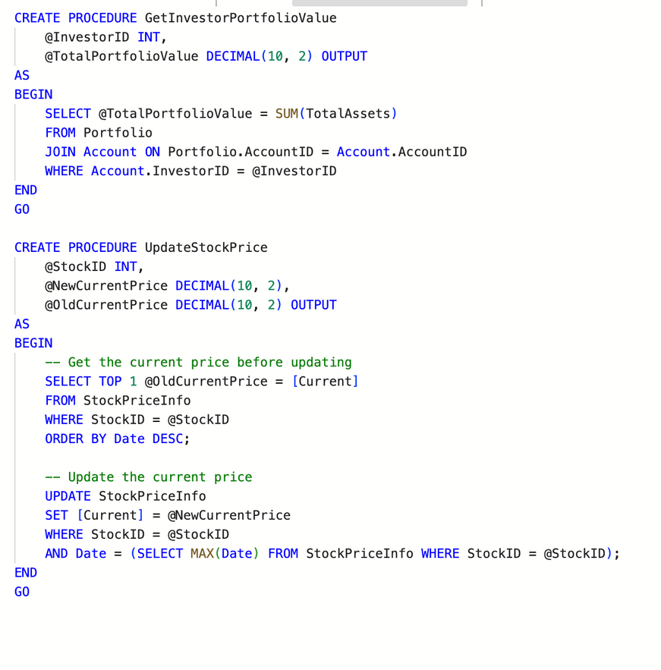
DATABASE OBJECTS
DDL & INSERT
STORED PROCEDURES

Slide 5
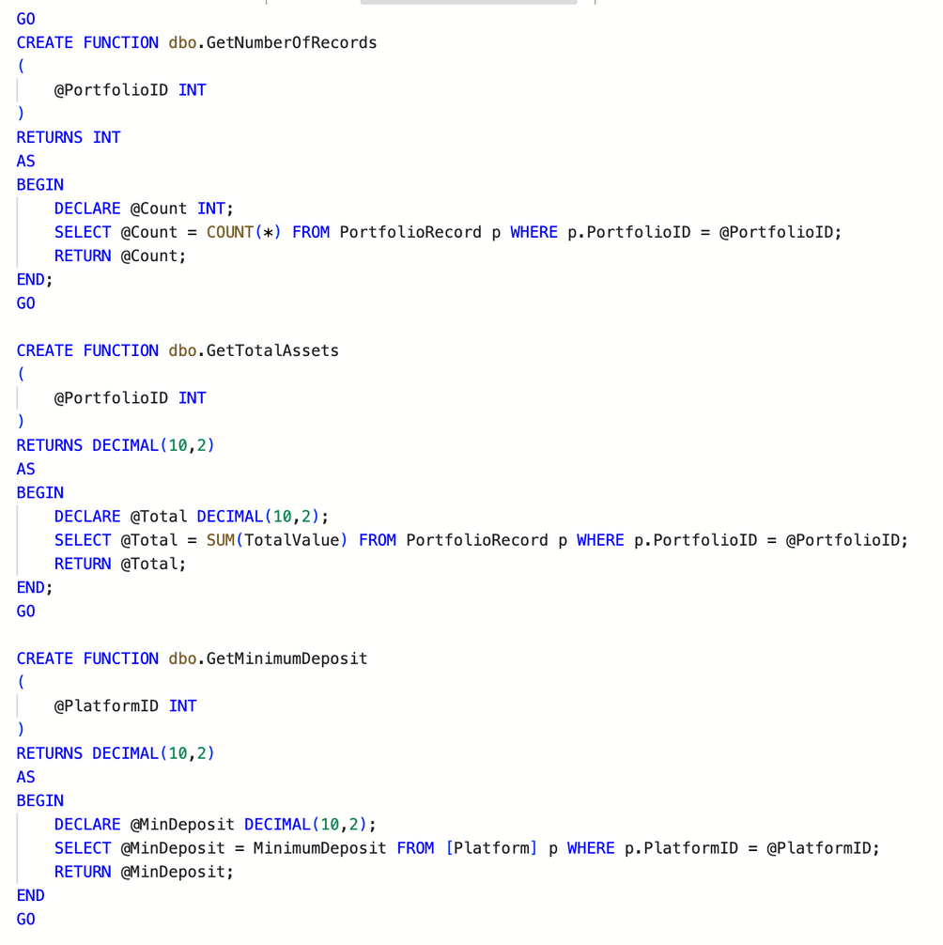
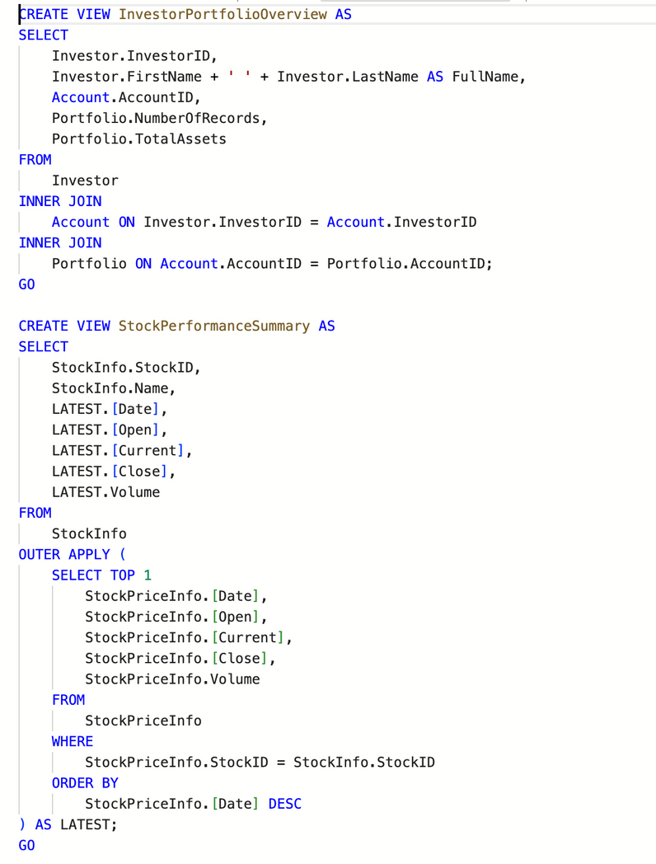
USER DEFINED FUNCTIONS
VIEWS

Slide 6
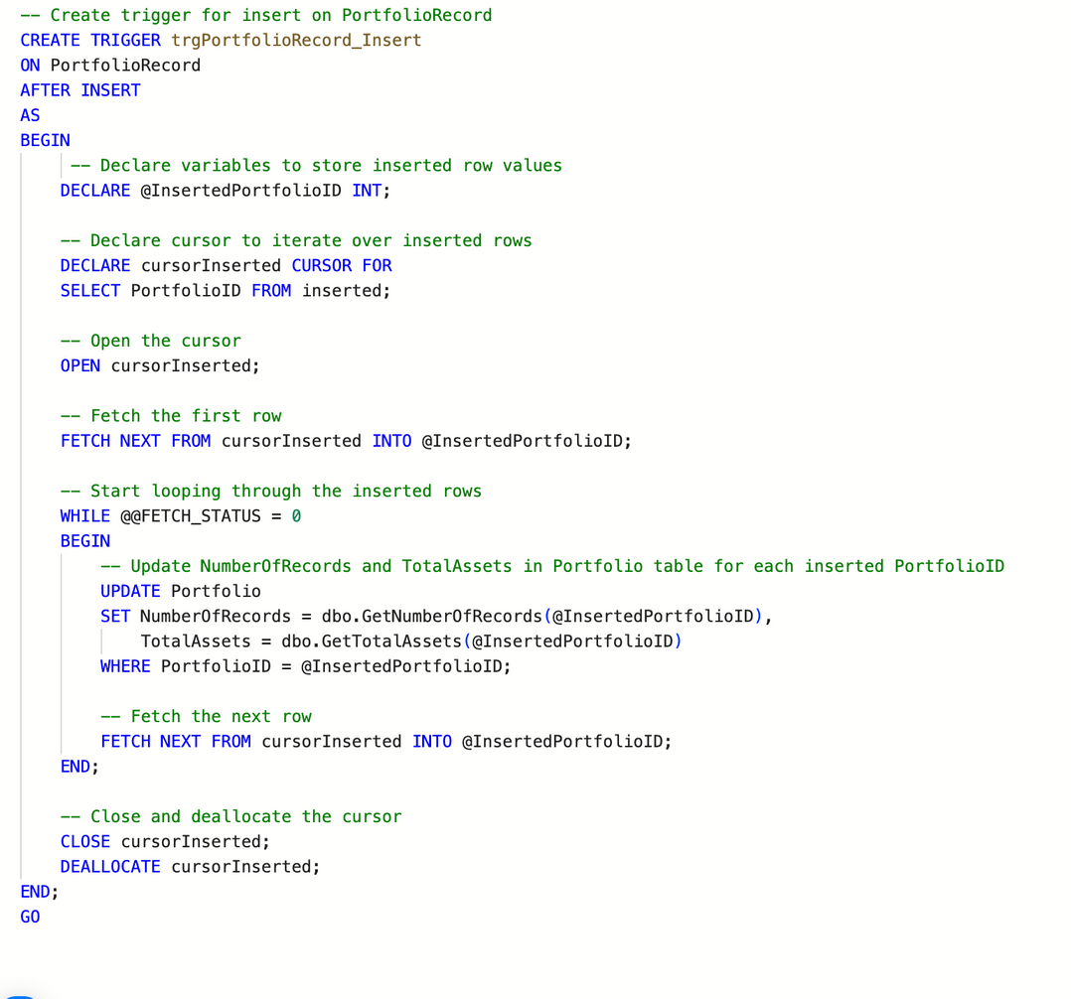
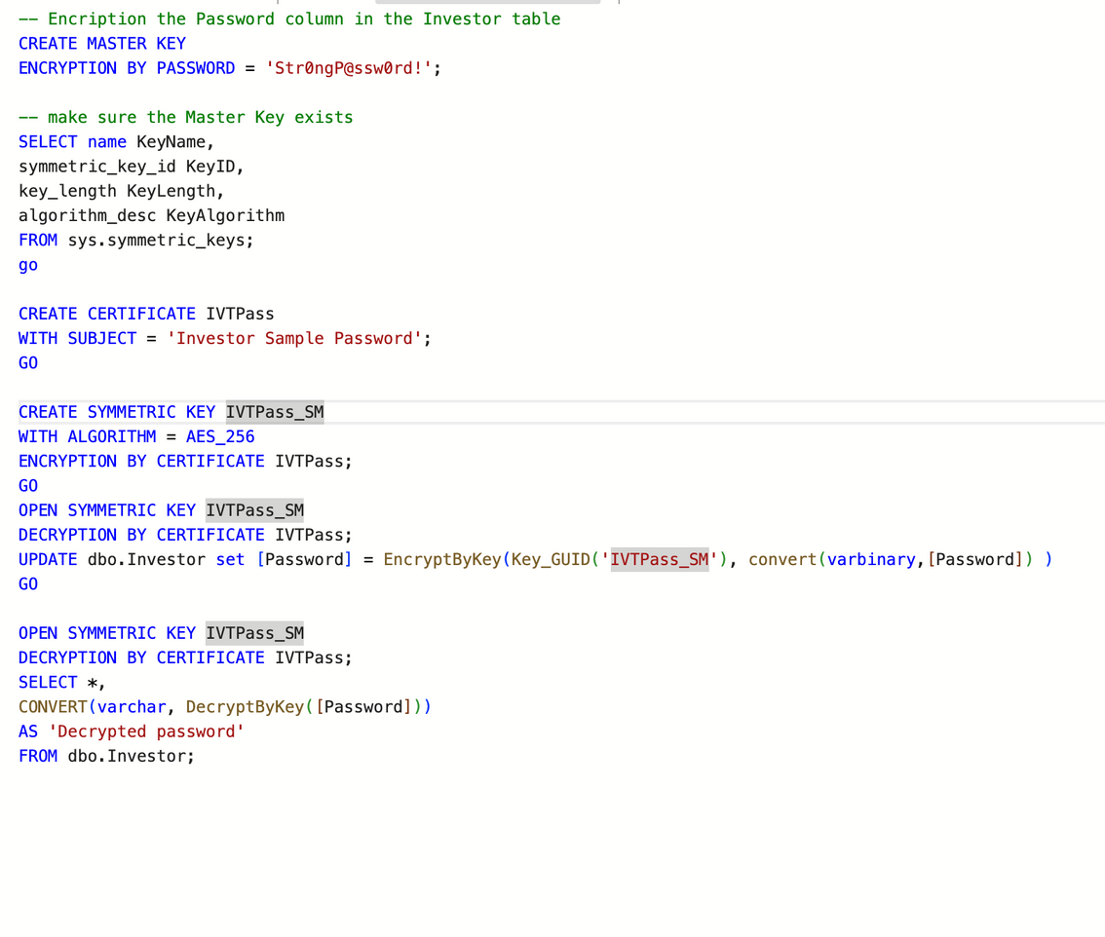
TRIGGERS & INDEXES
DATA ENCRYPTION

Slide 7
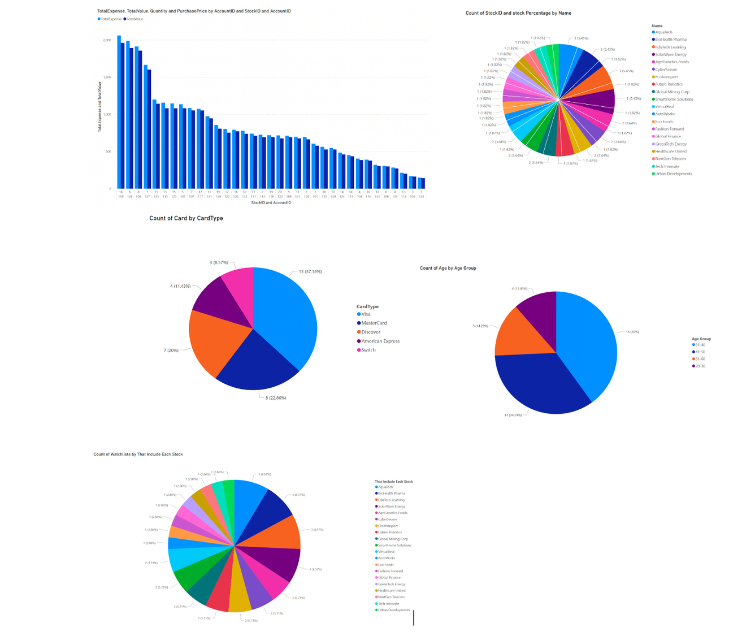

DATA VISUALISATION

Slide 8
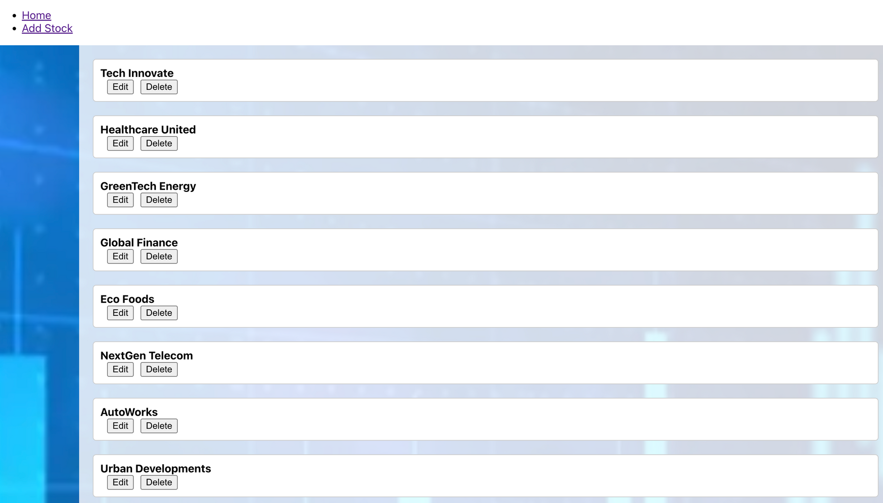
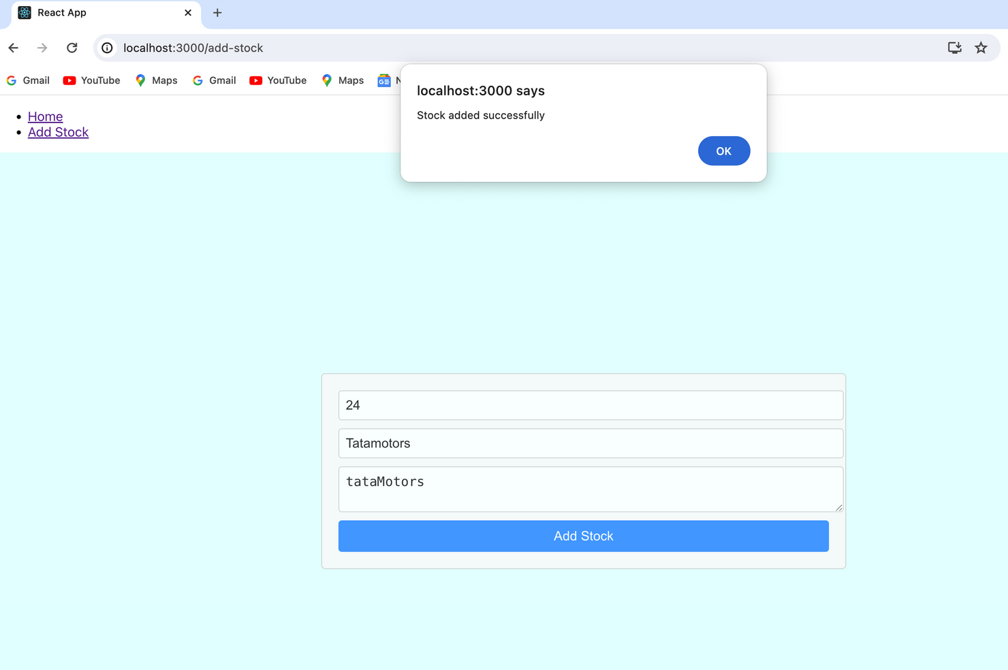
GUI

Slide 9
THANK YOU

